Slide 1


Know Your Brew!
Saifee, Courtney, Sarah and Aparna

Slide 2

Outline
Business Objectives (1-2 min)
Data Mining techniques (1-2 min)
Coding Approach (1 min)
Data/ App architecture (1-2 min)
Final Interactive Visualizations (2-4 min)
- Live Demo
- Screenshots and annotations
Appendix
Future Works (30 sec)

Slide 3
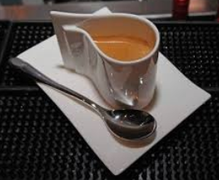
Project Overview
Our project goal is to start a coffee business and set up a website for that purpose.
Key areas:
Worldwide trend in Coffee production, export
Using YELP API, Tweepy to collect data from customers input of their interests from around the world
Webpages with information for customers

Slide 4

Data Sources and Analysis Approach
ICO Historical Data on the Global Coffee Trade for the year of 2016 and 2017

Slide 5


Slide 6
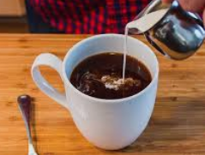

Slide 7


Slide 8

Data handling challenges
{
"type": "Feature",
"geometry": {
"type": "Point",
"coordinates": [ -74.297333,4.570868 ]
},
"properties": {
"rank":3,
"country":"Colombia",
"production":14634,
"export":12898
}
},
{
"rank":3,
"country":"Colombia",
"coordinates": [ 4.570868,-74.297333 ],
"production":14634,
"export":12898,
"radSize":20
},

Slide 9

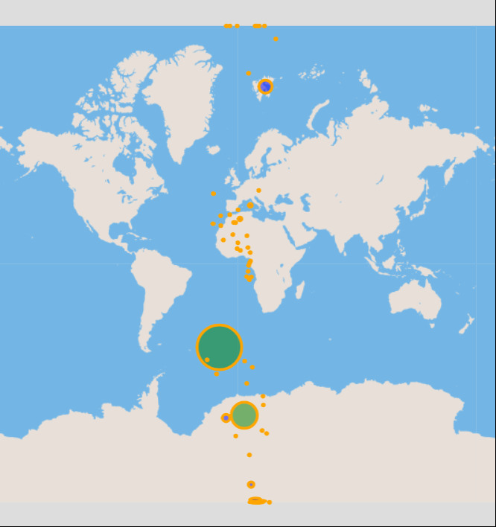
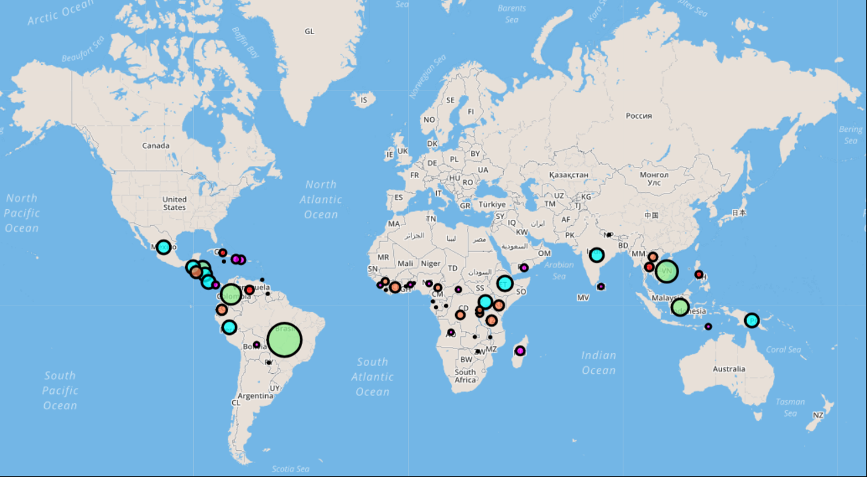
Difficulties

Slide 10

Resources
https://developers.google.com/public-data/docs/canonical/countries_csv (latlon)
http://www.convertcsv.com/csv-to-geojson.htm (csv converter)
https://www.kaggle.com/sbajew/icos-crop-data (ICO-cleaned data)
http://www.ico.org/new_historical.asp
http://www.ncausa.org/about-coffee/coffee-around-the-world
http://www.most-expensive.coffee/
https://financesonline.com/top-10-most-expensive-coffee-in-the-world-luwak-coffee-is-not-the-no-1/
https://www.worldatlas.com/articles/top-coffee-producing-countries.html

Slide 11



